Slide 1
Northeastern Ecosystem Services Assessment Fellowship
Alicia Coleman, University of Connecticut
(previously University of Massachusetts Amherst)
Mario Reinaldo Machado, University of Vermont
(previously Clark University)

Slide 2
Overview
Scope of Work
Methodology
Results & Recommendations
Next Steps

Slide 3
Scope of Work

Slide 4
Scope of Work
Inform the design and audience of a series of virtual listening sessions and the Working Symposium.
Increase the knowledge of Northeast LGU Extension and Research, partners, and producers on current northeast agricultural ecosystem services activities, opportunities, and gaps.
Integrate fragmented knowledge for future program, practice, and policy design.
Encourage dialogue between producers, LGU Extension and Research programs, and policymakers.
Along with the results from the virtual listening session and following working symposium, inform the potential development of funding streams, and integrated extension and research activities, policy proposals, and more. opportunities, and challenges.
RFP published 03/19/2021
With the right support, regional adoption of production practices that provide ecosystem services at scale can:
Increase farm profitability and sustainability;
2. Position agriculture as a leader in climate change mitigation/adaptation;
3. Build the resiliency of rural and urban communities;
4. Increase the appeal of agricultural professions to a wide range of young people.

Slide 5
Scope of Work
Identify the
organizational scope of relevant policies and programs
Document ag-related practices that procure ecosystem functions/ services
Report the breadth of incentives and rewards offered to ag-related producers for ecosystem function/service practices
Describe producers’ strategies to advertise ecosystem functions/services and boost revenue
1
2
3
4

Slide 6
Methodology

Slide 7
Methodology
Northeast Ecosystems Services Inventory
Identify the
organizational scope of relevant policies and programs
Document ag-related practices that procure ecosystem functions/ services
Report the breadth of incentives and rewards offered to ag-related producers for ecosystem function/service practices
Describe producers’ strategies to advertise ecosystem functions/services and boost revenue
1
2
3
4
Federal & state agencies
State AES
Regional commissions, NGOs
Local programs
(*DC and others)
Qualifying ag-related practices
Ecosystem services data
Intergovernmental Science-Policy Platform on Biodiversity and Ecosystem Services (IPBES 2017)
Incentive type
Incentive mechanism
Incentive type
Incentive mechanism

Slide 8
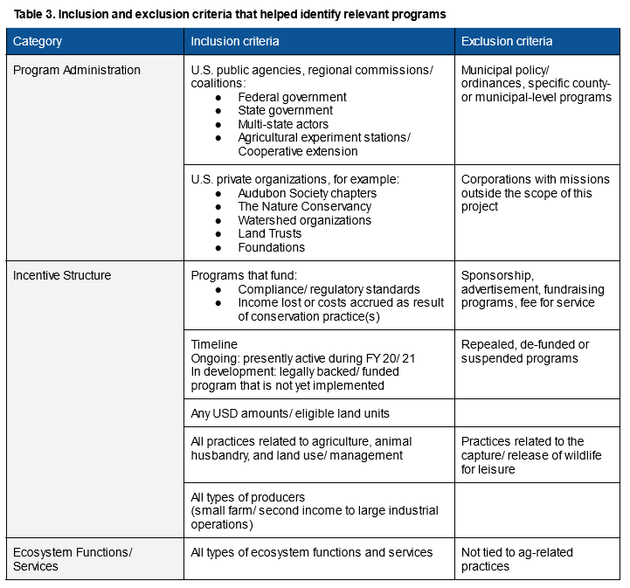
Methodology
Identify the
organizational scope of relevant policies and programs
1
Federal & state agencies
USDA Farm Service Agency, Ag. Marketing Service…
State extension programs
Regional commissions, NGOs
Local programs

Slide 9
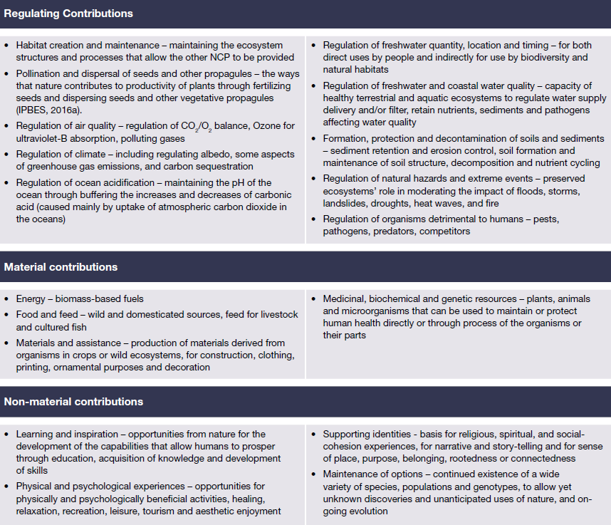
Methodology
Document ag-related practices that procure ecosystem functions/ services
2
Intergovernmental Science-Policy Platform on Biodiversity and Ecosystem Services
Pascual, U., et al. (2017). Valuing nature’s contributions to people: the IPBES Approach. Current Opinion in Environmental Sustainability, 26: 7-16.

Slide 10
Methodology
Direct incentive
direct monetary support; creates an immediate impact on individuals and/or the community, either because support is provided in-cash (sum of money) or in-kind (provide transferable benefit to improve everyday life)
In-cash (e.g. implementation grant, loan)
In-kind (e.g. public infrastructure, open-source information directories)
Indirect incentive
intended to protect, restore, enhance, or improve natural resources and land management practices without the transfer of direct monetary value
Fiscal (e.g. tax credit)
Services (e.g. technical assistance)
Social (e.g. partnership program)
Report the breadth of incentives and rewards offered to ag-related producers for ecosystem function/service practices
3
de Camino Velozo, R. (1987). Incentives for community involvement in conservation programmes. FAO Conservation Guide (FAO)
Anderson, R.C. (2001). The United States Experience with Economic Incentives for Protecting the Environment. Paper number EE-0216B, EPA-240-R-01-001.
Piñeiro, V., et al. (2020). A scoping review on incentives for adoption of sustainable agricultural practices and their outcomes. Nature Sustainability, 3(10), 809-820.

Slide 11
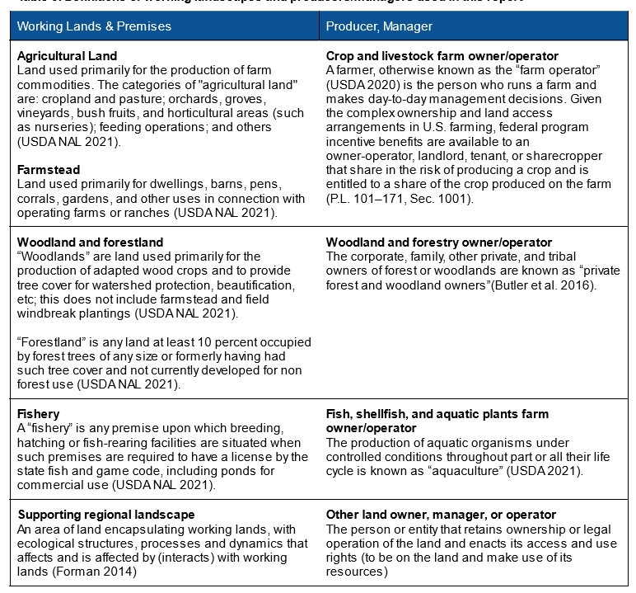
Methodology
Describe producers’ strategies to advertise ecosystem functions/services and boost revenue
4
certifications/ certificates of compliance

Slide 12
Results & Recommendations

Slide 13
Results & Recommendations
 | Total number of programs in database
 | Producers/Managers | Supporting Institutions
Food, farming, agriculture | 535 | 55
Working forests and woodlands | 97 | 26
Fisheries, aquaculture, and shellfish operations | 64 | 20
Supporting landscapes and systems | 286 | 206
total | 982 | 307
Grand total | 1,289

Slide 14
Results & Recommendations
Increasing farm profitability and sustainability
Public & private sector certifications
Practices
Bee Friendly Farming (Pollinator Partnership)
Salmon Welfare Certified (A Greener World)
Bird-Friendly Maple Syrup (VT)
Products
True Blue Crab Meat program (MD)
Connecticut Grown Forest Products (CT)
Carbon credit programs
Places
Century and Bicentennial Farm (PA)
Ocean Friendly Restaurant (Surfrider Foundation)
Tree City USA
Implementation grants and loans
Partner Community Capital Local Food Value Chains Initiative (WV)
Community Wood Energy and Wood Innovation Grant Program (USDA)
Financial planning
Technical assistance & education (Conservation Finance Centers)
Producers and land managers operate according to the "safety-first" principle and are often risk-averse. In order to be successful, practices and programs must sufficiently and sustainably offset these risks in concrete ways.
What are the ecological and economic trade-offs of a particular (sub)region? What is the best type of data to understand how various incentive structures may impact different producers differently in this context?
How can incentive mechanisms and robust social networks work to scale up ecosystem service provisioning programs to achieve changes beyond individual farms/producers?
Notes:
Recommendation 1.1: Balance long-term ecological considerations with short-term economic returns by avoiding tradeoffs and diversifying direct and indirect incentives.
Recommendation 1.2: Promote ecosystem service provisioning on smaller scales (e.g. the household, farm, or community) to illustrate value, ensure long-term sustainability, and maintain local stakeholder participation.

Slide 15
Results & Recommendations
Positioning agriculture and forestry as primary leaders in mitigating climate change
Programs are structured to either incentivize a single ecosystem service or multiple layered services. Project design should account for those strengths and weaknesses as well as the potential to scale practices from individual farms to multifunctional landscapes.
How do ecosystem service needs assessments change across scales? Why does this matter for Northeast _____?
producers/managers
public agencies
private commerce
…
How do disparities and injustices affect the provisioning of ecosystem services? How does program access and change across populations?
Land protection, easement, PES
Community Foundation (Maine)
Open Space Program (DE)
USDA Conservation Reserve Program (CRP)
Leasing, selling, disposing public land
Urban Farming Land Lease Program (DC)
Farmland (Land) Access Program (RI)
Shellfish grounds (CT, RI)
USFWS/USDA FSA Inventory Property Disposal Program
Regenerative practices
Cover Crop Program (MD)
Integrated Pest Management (Northeastern IPM)
New Farmer Training (NOFA)
Notes:
Recommendation 2.1: Conduct an expert panel of the strategic ecosystem services priorities for the region and compare to IPBES priorities for the Americas to assess gaps and opportunities for cross-scalar synergies.
Recommendation 2.2: Programs to provision ecosystem services are differentially accessible. Ecosystem services themselves impact communities differently. It is important to consider not only the effects of programs on ecosystem services but also their effects on equity.

Slide 16
Results & Recommendations
Building resiliency of rural and urban communities
Very few programs reviewed in this assessment directly address resilience and fewer directly address resilience beyond the farm-scale.
How do different forms of resilience relate across scale (household, community, ecological units)?
What organizational and governance structures exist, overlap, or undermine existing efforts?
What is the role of community engagement in environmental monitoring?
Small business and farmer resilience
Risk Reduction for Small Business Resilience program (RI)
Farm resilience programs (ME, NOFA-VT)
Community resilience
For local government and NGOs (MD, RI)
Coastal resilience
National Coastal Resilience Fund
(USFWS, National Fish and Wildlife Foundation)
Coastal resilience grant (NOAA)
Notes:
Recommendation 3.1: Identify the indicators of resilience (e.g. for whom, by whom, for what, over what time period) at various scales and for various stakeholders across the U.S. Northeast.
Recommendation 3.2: Evaluate the effect of regional consortia and the role of existing governance and institutional structures, especially conservation districts and higher education.

Slide 17
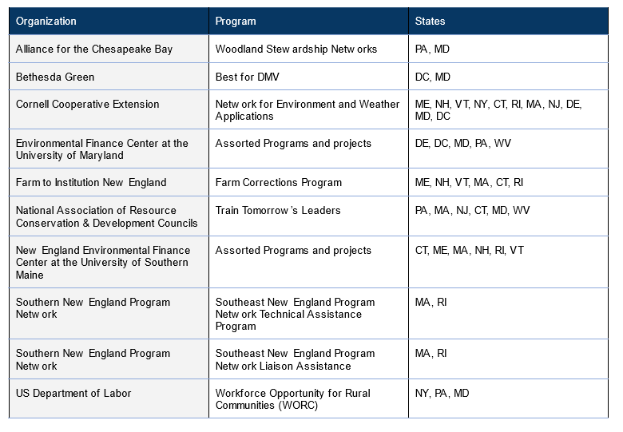
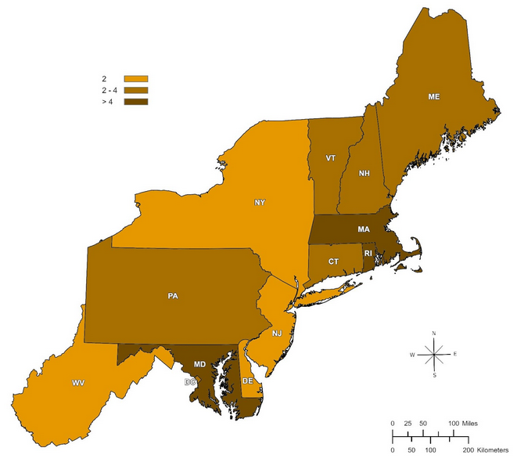
Results & Recommendations
Increasing the appeal of agricultural professions to a wide range of young people
Ecosystem service provisioning programs for young and beginner farmers, while important, may not be enough to entice young people into working-lands related careers. Programs that couple ecosystem service provisioning with incentives that directly support livelihood provisioning such as cash-in-hand (basic income), land access/acquisition, free education/professional development, and healthcare, may help.
What are the land tenure, healthcare, and educational limitations of new entrants?
What incentive structures and mechanisms overcome key hurdles?
How can cash-transfer/basic income programs work to expand the capacity of ecosystem service provisioning?
Notes:
Recommendation 4.1: Evaluate the regionally specific factors inhibiting youth from working-lands careers in the U.S. Northeast, with a particular eye on issues of land tenure, childcare, health care, and higher education.
Recommendation 4.2: Evaluate the role of cash-transfer and basic income programs to supplement conventional, market-based systems.

Slide 18
Next Steps

Slide 19
Next Steps
Deliverables (late March)
Digital e-reader final report
‘Database’ of programs
Conferences
Northeastern Agricultural and Resource Economics Association (NAREA) post-conference workshop "Ecosystem Services Foundations for Resilient Communities: Agriculture, Land Use, Coasts and Energy for Human Well-Being"
American Collegiate Schools of Planning (ACSP) Annual Conference
Postdoctoral research
Applied Forest Ecology Lab, Department of Natural Resources and the Environment, University of Connecticut
Gund Institute for Environment, University of Vermont
USDA NRCS Conservation Innovation Grant, Regenerative Agriculture/Grazing
Vermont Pay for Phosphorus Program
PES Landscape Survey in California (Sustainable Groundwater Act 2014)

Slide 20
Thank You!
alicia.f.coleman@gmail.com @af_coleman
mariormachado128@gmail.com @Mario_R_Machado

